Slide 1
Simulating Bokeh effect in portrait photograph
using Image Matting
Stuti Sakhi
Nitin Chakravarthy
Amiya Panda

Slide 2
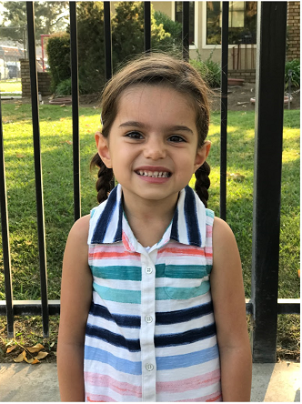
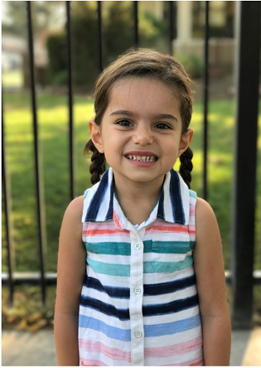
Problem Statement
Simulate background blur or bokeh effect in a image

Slide 3
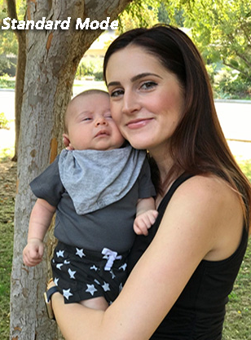
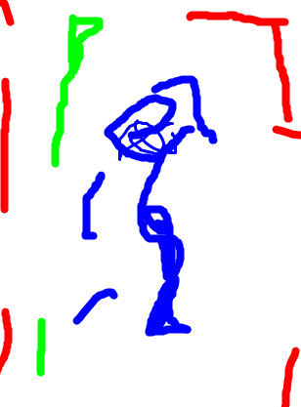
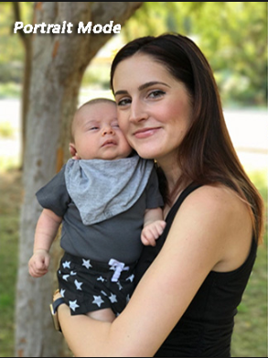
Approach:
Multi-level Matting
Multiple Depth Levels
Level wise Blurring
Blurred Levels
Stacking
Input Image
Input Scribble
Output
Notes:
on a higher level these would be the steps that we will be following.
First the user specifies the regions to blur and not to blur with different colors. We consider the foremost object as the blue scribble , next as green and the background as red.
Then we pose the problem into a multi layered matting problem to obtain a probabilistic value of each unmakred pixel being in a certain layer using the sribble constraints.
Then we use multiple gaussian filters with different spreads to perfrom a levelwise blurring operation for the corresponding levels.
Then we stack the corresponding pixels from each layer into a single image with background blur

Slide 4
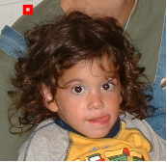
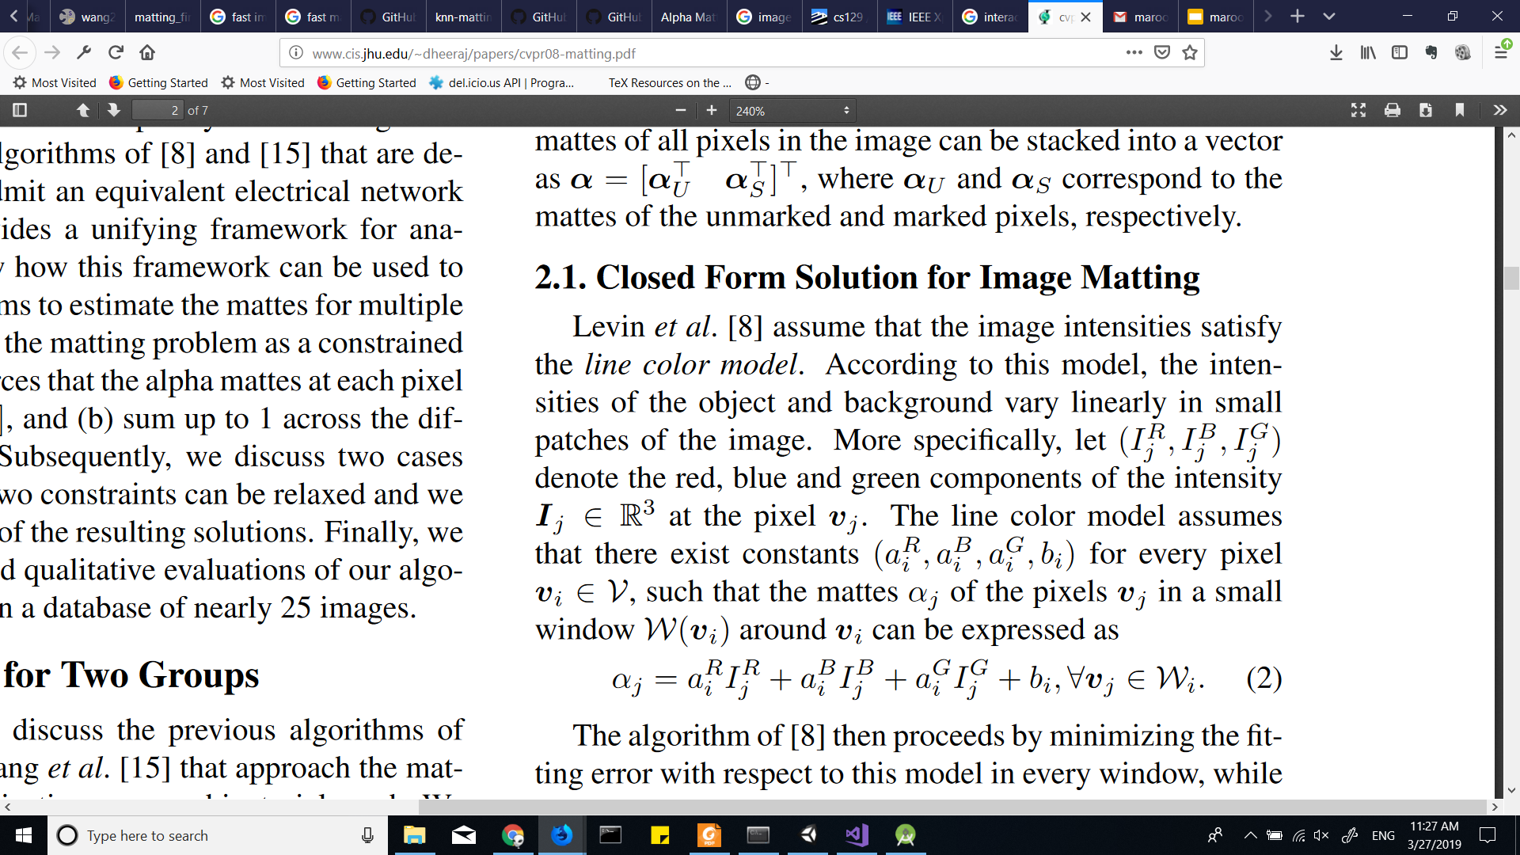

Closed Form Solution for 2-Level Matting
Task : Find a matting coefficient α for each pixel which represents the probability of each pixel belonging to the foreground.
Assumption : Color Line Model
α is a linear combination of the R, G, B intensities in a window

Slide 5
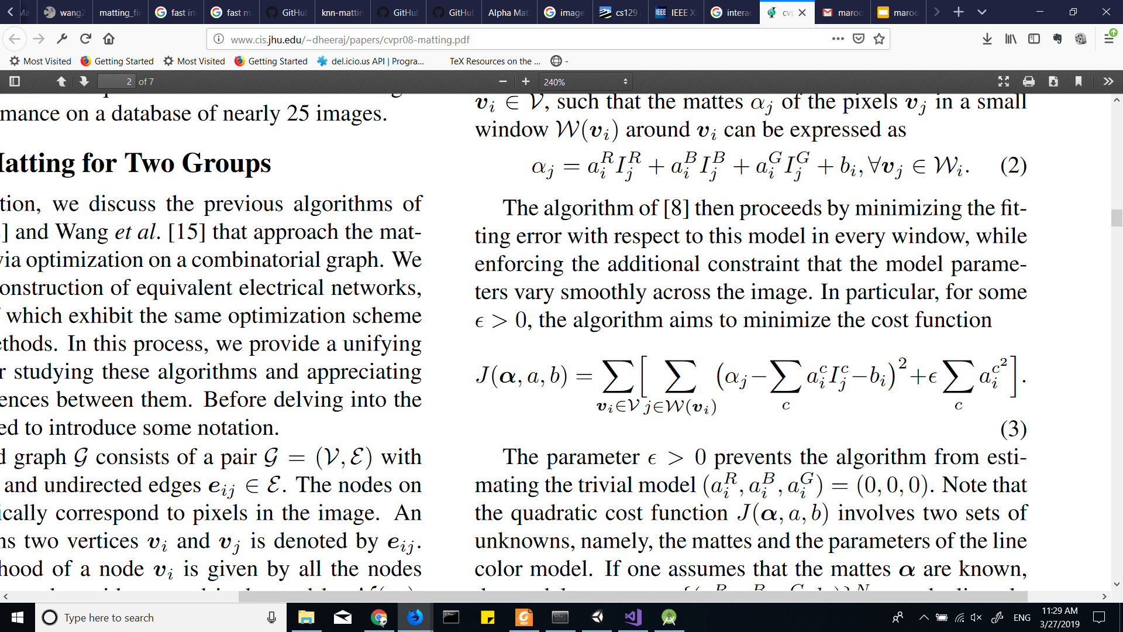
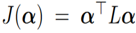
Closed Form Solution for 2-Level Matting
Objective Function : Mean Square Error with Regularization
α : Matting Coefficient for each pixel (N x 1)
L : Matting Laplacian Matrix (N x N)
N : Number of pixels in image

Slide 6
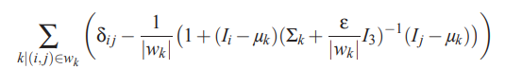
Closed Form Solution for 2-Level Matting
Matting Laplacian Matrix: We take 3 x 3 windows in an image at every pixel (without padding). Laplacian is N x N array whose (i, j) element is given by
W_{k} : Number of pixels in window
μ_{k} : Mean of pixels in window
∑_{k}: Covariance Matrix of window
I_{i} : Pixel values at index i in flattened image

Slide 7
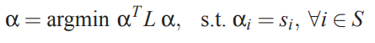
Closed Form Solution for 2-Level Matting
Final Formulation:
This is a Quadratic Programming problem with only equality constraints.
It can be converted to Linear Programming problem and solved.
Notes:
Talk about expanding to Multi level case. And python function u used.

Slide 8
Matting Results
Add an image, scribble input and various level outputs predicted

Slide 9
Blurring
We blur each level with increasing blurring kernel as the depth increases and then stack them together
Add blur images(if possible) and Final stacked image

Slide 10
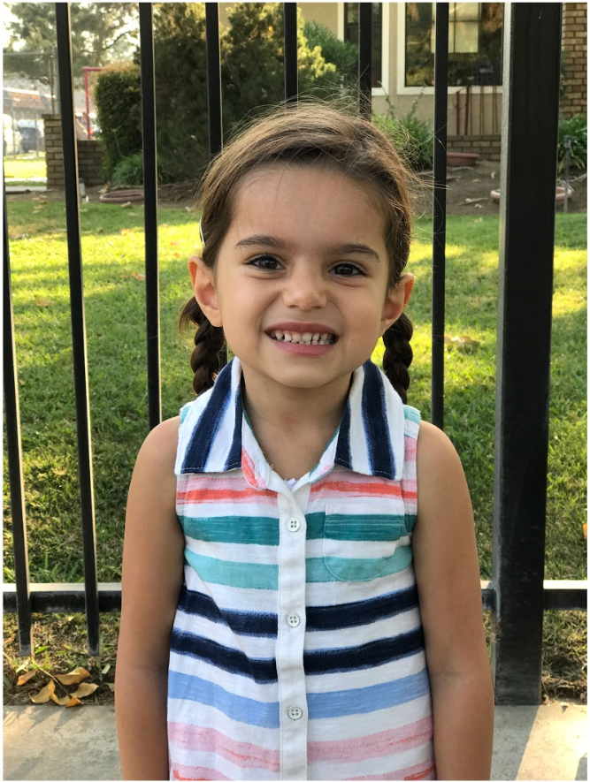
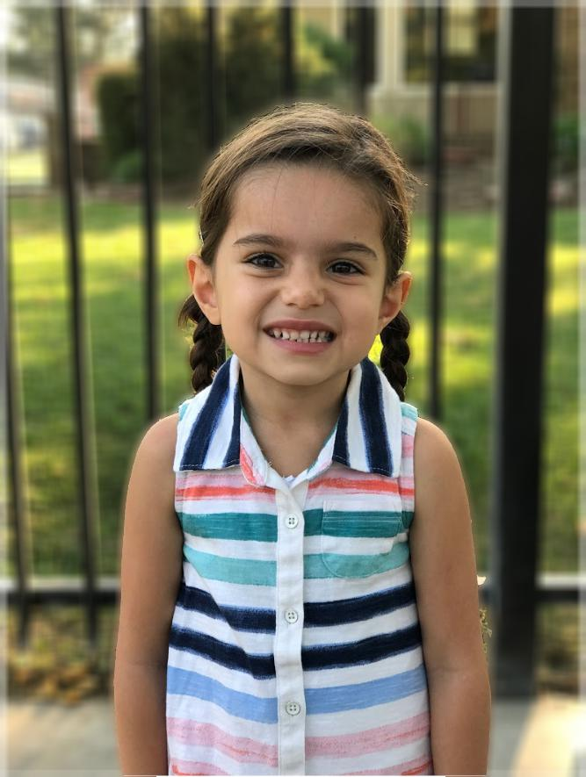
Bokeh Results

Slide 11
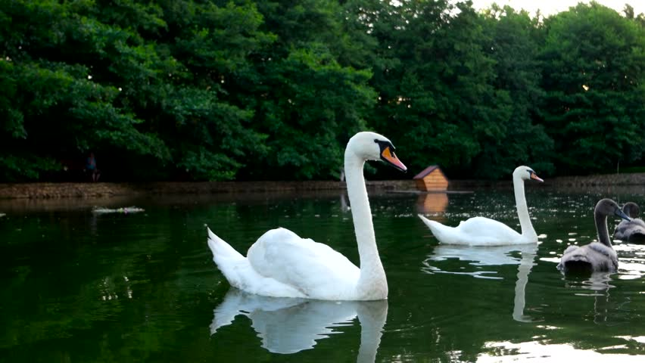

Bokeh Results

Slide 12
Thank you

